Slide 1


Cloud computing
for education and research
Practice 01. Spring boot

Slide 2
Kubernetes
01
Concept
Containers occasters that make a cluster of servers running containers into one large logical server
Continuously compare the specified status with the current status and adjust it to match
Supports non-disruptive rolling upgrades using techniques such as blue/green deployment or canary deployment while deploying and running containers
Abnormal containers are restarted by live probe
Limit the amount of resources a container group can consume at the namespace level
Provides service discovery for pods and containers
Defining service objects allows you to load balance requests to available pods and discover services
Provides a flat IP network that allocates an IP address to each pod and allows access to other pods regardless of node
To support multiple network vendors, Kubernetes allows the use of network plug-ins that comply with the Container Network Interface (CNI) specification

Slide 3
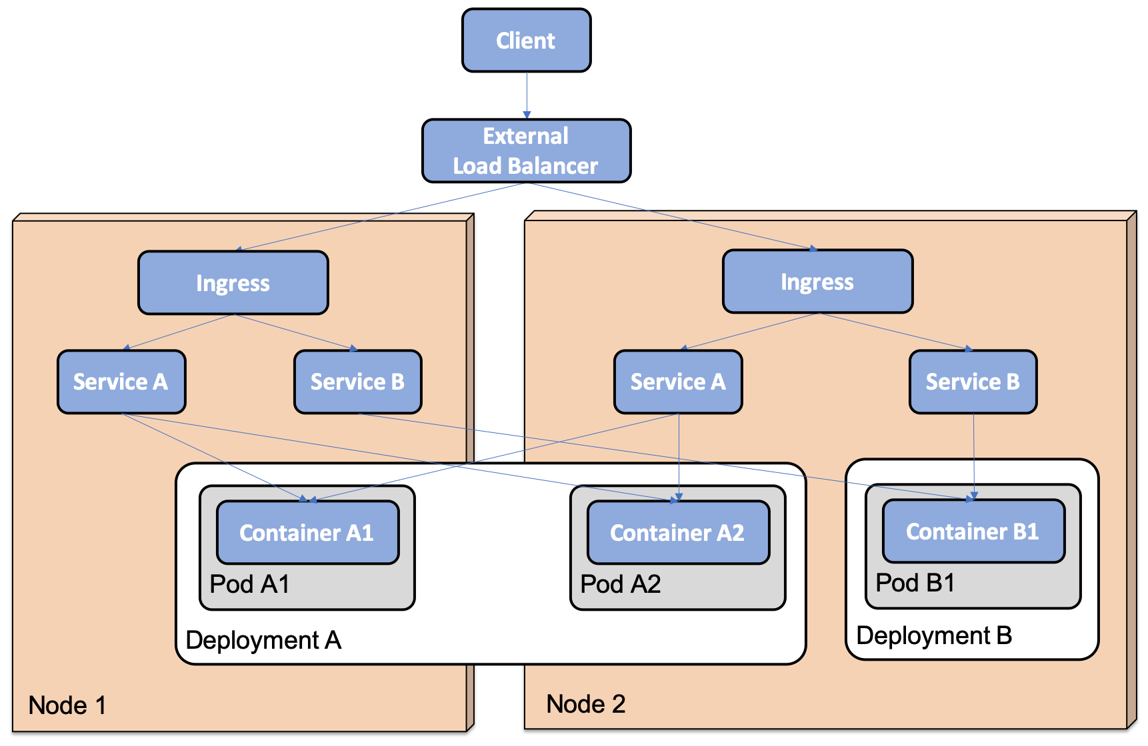
Kubernetes
01
Concept
Ford is not quarantined and accepts all incoming requests
Role-based access control (RBAC) is applicable

Slide 4
Kubernetes
01
Run-time component
Components running on the master node (control plane)
API Server: Entry point of the control plane. Provide REST API used by kubectl
etcd: Store all data in the cluster
Control Manager: Includes controllers that compare the current state of the object defined in etcd with the desired state and evaluate it continuously
Scheduler: Allocate newly created containers to appropriate nodes by considering available memory, CPU, etc

Slide 5
Kubernetes
01
Run-time component
Components running on worker nodes (data plane)
kubelet: a node agent that runs directly on the node's operating system, not as a container
Kube-proxy: a network proxy that implements Kubernetes' concept of service. Transfer requests to appropriate pods
Container Runtime: Software that runs containers on nodes. Generally, dockers are used. Any implementation of the container runtime interface (CRI) is available. e.g.) CRI-O, containerd, rktlet
Kubernetes DNS: DNS server used by the internal network of the cluster. DNS server is distributed as a deployment object and service object

Slide 6
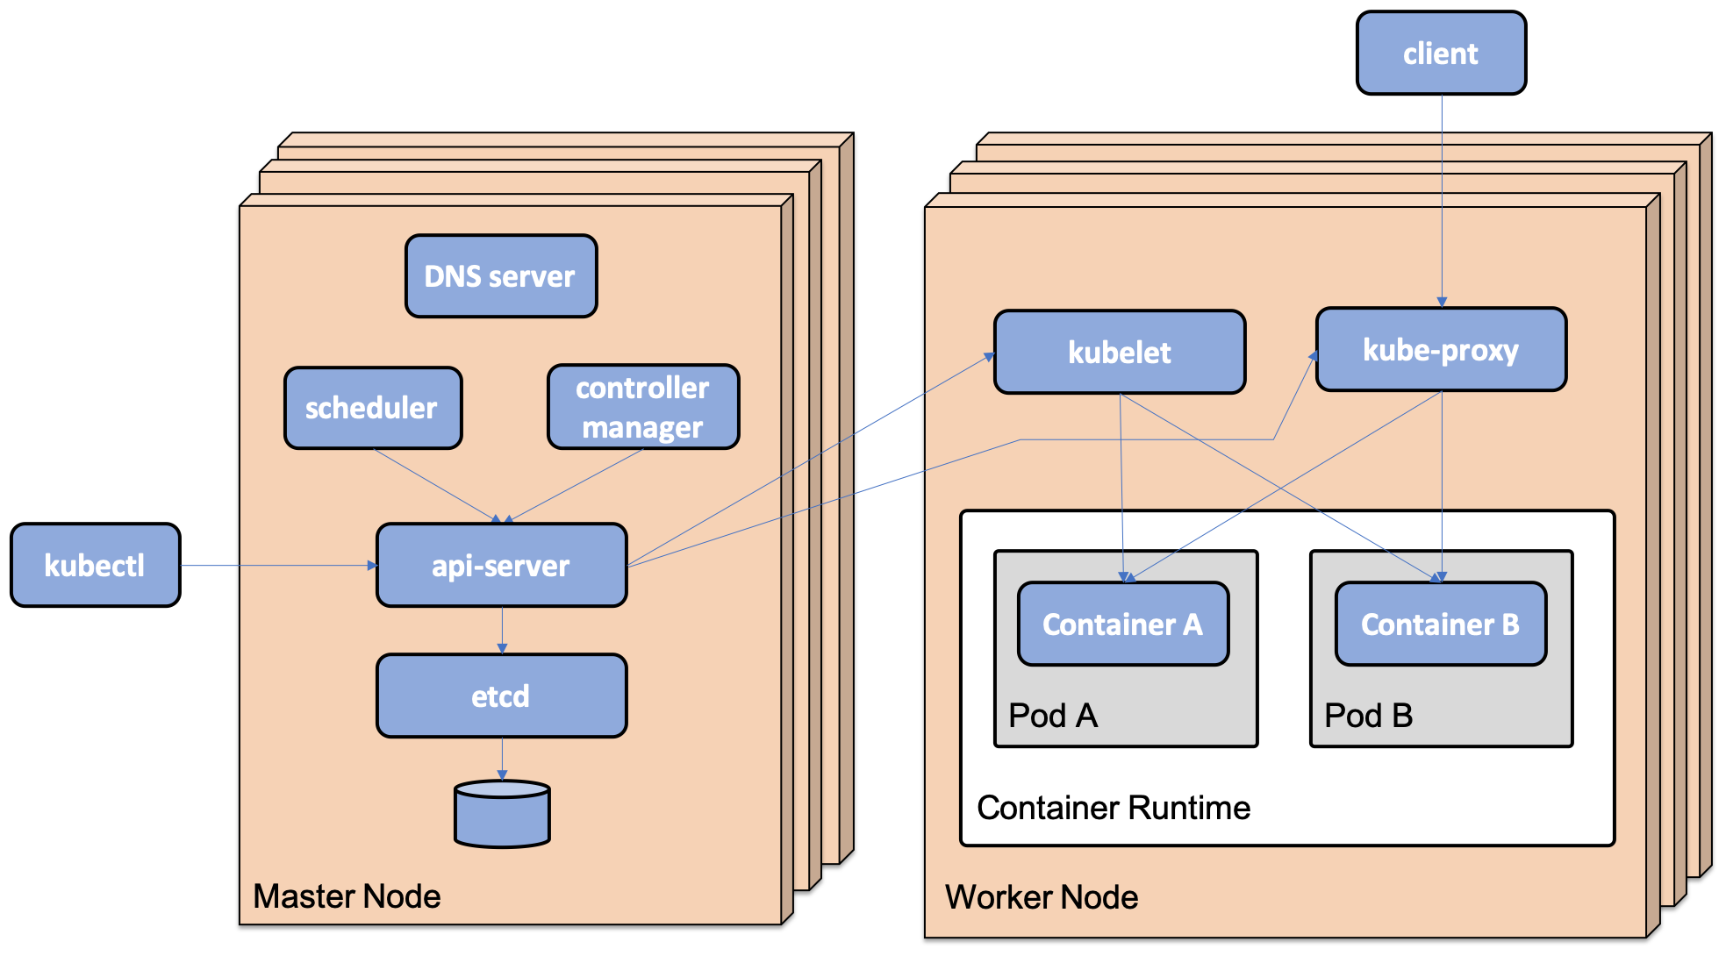
Kubernetes
01
Run-time component

Slide 7
Kubernetes
01
minikube profile
To run multiple Kubernetes clusters locally, Minicube offers the concept of a profile
Multiple clusters can be created. Assign a separate profile to each cluster
minikube profile my-profile: my-profile profile set up
minikube config get profile: 현재 profile comfirm
The profile information currently in use is in the ~/.minikube/profiles folder
kubectl get: Show information on the specified API object
kubectl describe: shows details of the specified API object
kubectlogs: Log output from container

Slide 8

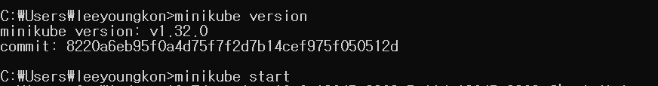
Kubernetes
01
installing minikube
Modify the .wslconfigure file (within %UserProfile% folder) as below to free up enough resources and re-run the docker
Download and install minikube from https://minikube.sigs.k8s.io/docs/start/
minikube version confirmation
minikube start run

Slide 9
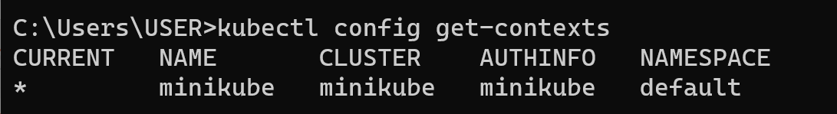
Kubernetes
01
kubectl context
kubectl provides the concept of contex in case of working with more than one cluster
The contex consists of the following elements
kubernetes cluster
User credentials
Default Namespace
Contact is stored in ~/.kube/config
When creating a minicube Kubernetes cluster, a context with the same name as the minicube profile is created, and this context is set to the current context
You can view the contacts that you can use with the following commands.
kubectl config get-contexts

Slide 10
Kubernetes
01
kubectl context
Run the following command to switch the current context to another context and work in a different cluster
kubectl config use-context my-cluster
If contact update action is required, run the following command
kubectl config set-context
For example, to change the default namespace of the current context to my-namespace, give the command
kubectl config set-context $(kubectl config current-context) --namespace my-namespace

Slide 11
Kubernetes
01
Create a cluster
The following command must be executed
Release the KUBECONFIG environment variable so that the kubectl context is created in the default configuration file (~/.kube/config)
Specify the minicube profile that the cluster will use
The minikube start command allows you to specify the hardware resources to allocate to the cluster when creating the cluster
After cluster creation, use Minicube's add-on administrator to activate the ingress controller and the metric server embedded in the Minicube
unset KUBECONFIG
minikube start -p my-profile
minikube start
minikube addons enable ingress
minikube addons enable metrics-server

Slide 12
Kubernetes
01
Creating and Specifying Namespace
Create the first-attempts namespace and designate it as the default namespace for kubectl contacts
kubectl create namespace first-attempts
kubectl config set-context --current --namespace=first-attempts
kubectl config current-context (check current context)

Slide 13
Kubernetes
01
apiVersion: apps/v1
kind: Deployment
metadata:
name: nginx-deploy
spec:
replicas: 1
selector:
matchLabels:
app: nginx-app
template:
metadata:
labels:
app: nginx-app
spec:
containers:
- name: nginx-container
image: nginx:latest
ports:
- containerPort: 80
Create pod using nginx-deployment.yaml
Create pod command
kubectl apply -f nginx-deployment.yaml
delete pod command
kubectl delete pod --selector app=nginx-app

Slide 14
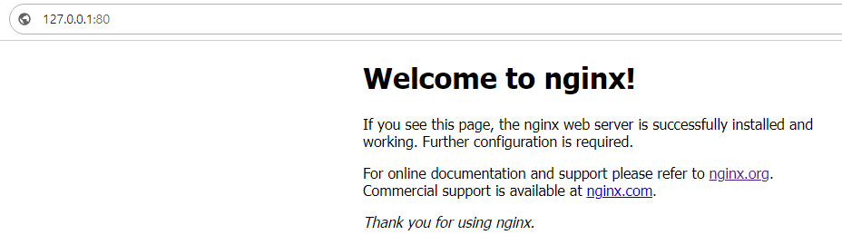
Kubernetes
01
Create services to communicate with the outside world
apiVersion: v1
kind: Service
metadata:
name: nginx-service
spec:
type: NodePort
selector:
app: nginx-app
ports:
- targetPort: 80
port: 80
nodePort: 30080
Run the service with the following command
kubectl apply –f nginx-service.yaml
Use the command below to check service information
kubectl get services
Know Minicube external ip
minikube ip
Port forward with the command below and access the web
kubectl port-forward deployment/nginx-deploy 80

Slide 15
Kubernetes
01
Cluster Management
Suspend Cluster
minikube stop
Restarting the Cluster
minikube start
Restarting the cluster changes kubectl context to use this cluster, with the namespace set to default. To replace it with my-namespace, do it below
kubectl config set-context --current --namespace=my-namespace
Shutting Down a Cluster
minikube delete --profile my-profile
Delete minikube completely
minikube delete --all --purge

Slide 16
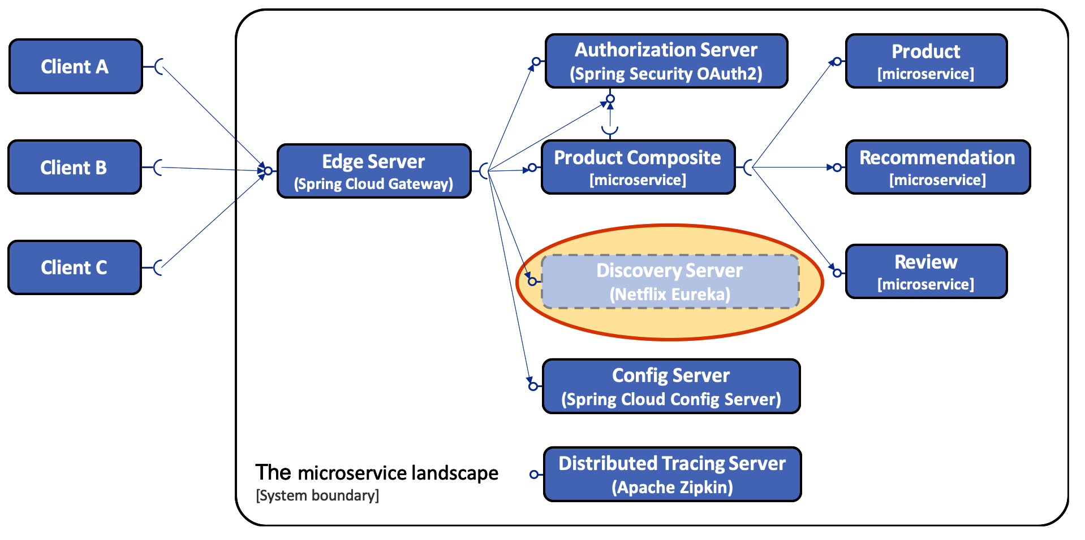
Kubernetes
01
Replace Eureka with Kubernetes Service
Kubernetes has built-in search capabilities based on service objects and kube-proxy
No need to deploy separate search services such as Eureka
You also don't need client libraries like Netflix ribbons
This enables Kubernetes search services to be used regardless of microservice-based language or framework

Slide 17
Kubernetes
01
Replace Eureka with Kubernetes Service
Remove client and server configurations associated with Eureka and ribbon from config-repo
Remove routing rules to eureka servers from the config-repo/gateway.yml file of the gateway service
Remove Eureka Server Project
Removing the Eureka Server from the Docker Components File and from the pom.xml
Remove spring-cloud-starter-Netflix-eureka-client dependencies from build files for all Eureka clients
Remove the eureka.client.enabled=false property from all Eureka client integration tests
Change the HTTP port used by the microservice and authorization server from 8080 to the default HTTP port of 80

Slide 18
Kubernetes
01
Introduction to Kustomize
kcustomize is a tool used to customize Kubernetes yaml files for various environments such as development, testing, preparation, and commercial environments
Store common definition files in the base folder and store additional environmental information in the environmental overlay folder
Information by Environment
Version of docker image to use
Number of replicas to run
Resource allocations, such as CPU, memory, etc
Each folder has a customization.yml file that describes the content to be used by kcustomize
Kcustomize sends the result of a combination of content from a base folder and an environmental overlay folder to kubectl
Basic customization is supported through kubectl-k from version 1.14 of Kubernetes
To deploy to a development environment using kcustomize
kubectl apply -k kubernetes/services/overlays/dev 커맨드 사용

Slide 19
Kubernetes
01
Introduction to Kustomize
Base folder contains definition files for resource manager and microservice
Deploy and use resource managers in Kubernetes only in a development environment
The definition file in the base folder defines the deployment object and service object for each microservice

Slide 20
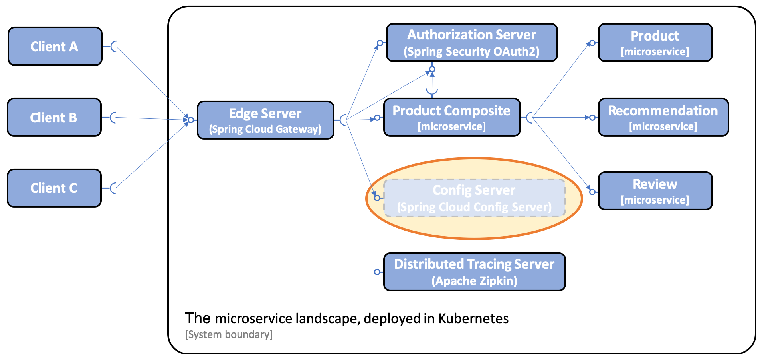
Kubernetes
01
Replacing the Spring Cloud Configuration Server
Configuration servers consume a lot of resources and take a long time to start
Kubernetes config map and secret use much faster and use less resources

Slide 21
Kubernetes
01
Replacing the Spring Cloud Configuration Server
Remove spring-cloud/config-server project
Remove configuration from all microservices
Change the configuration file in the config-repo folder
Change Kubernetes Deployment Resource Definition File
A volume mounted configuration map is associated with a folder in the container file system, through which the microservice imports the configuration files in the configuration app
Define the SPRING_CONFIG_LOCATION environment variable that specifies the path of the configuration file on the volume
Define credentials for resource manager access using Secret

Slide 22
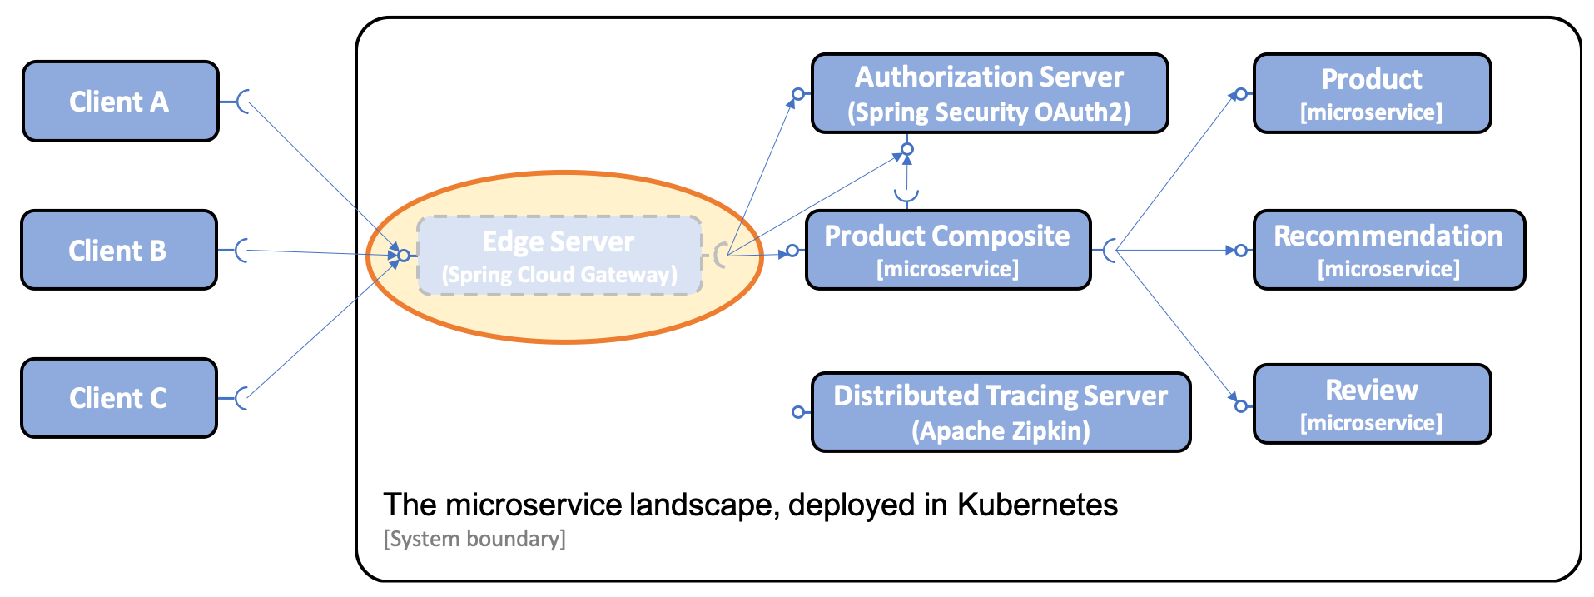
Kubernetes
01
Spring Cloud Gateway Replacement
Replacing Spring Cloud Gateway with Ingress Resources from Kubernetes
Can operate as an edge server using ingress
Ingress is a built-in feature from Kubernetes and can be extended to automatically provision certificates using the Cert manager

Slide 23
Kubernetes
01
Defining Ingress Resources
apiVersion: extensions/v1beta1
kind: Ingress
metadata:
name: edge
spec:
tls:
- hosts:
- minikube.me
secretName: tls-certificate
rules:
- host: minikube.me
http:
paths:
- path: /oauth
backend:
serviceName: auth-server
servicePort: 80
- path: /product-composite
backend:
serviceName: product-composite
servicePort: 80
- path: /actuator/health
backend:
serviceName: product-composite
servicePort: 80

Slide 24
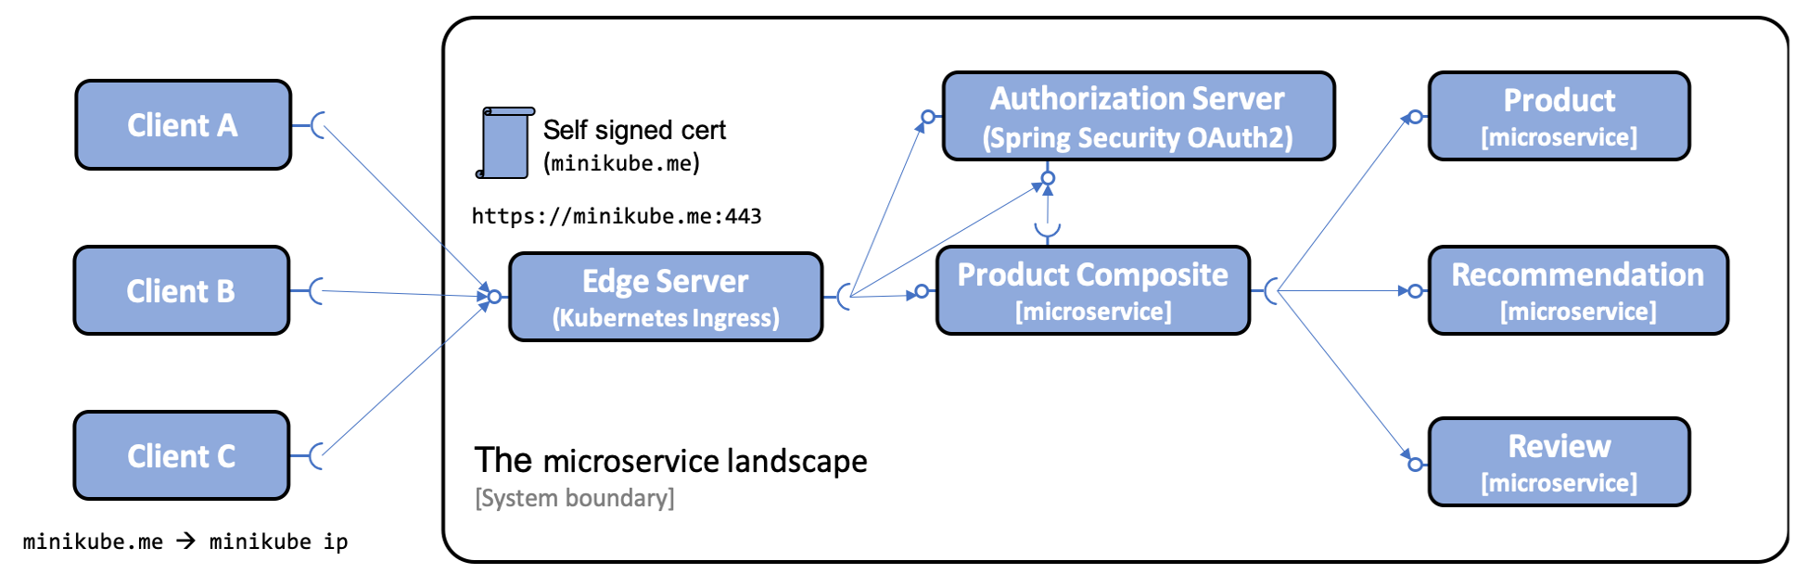
Kubernetes
01
Testing with Kubernetes Config Maps, Secrets, and Ingress Resources
Test system environment by replacing configuration maps, secrets, and ingress resources
Ingress exposure to 443 ports, the default HTTPS port for minicube instances
An ingress controller installed with minikube addons enable ingress is required for this operation

Slide 25
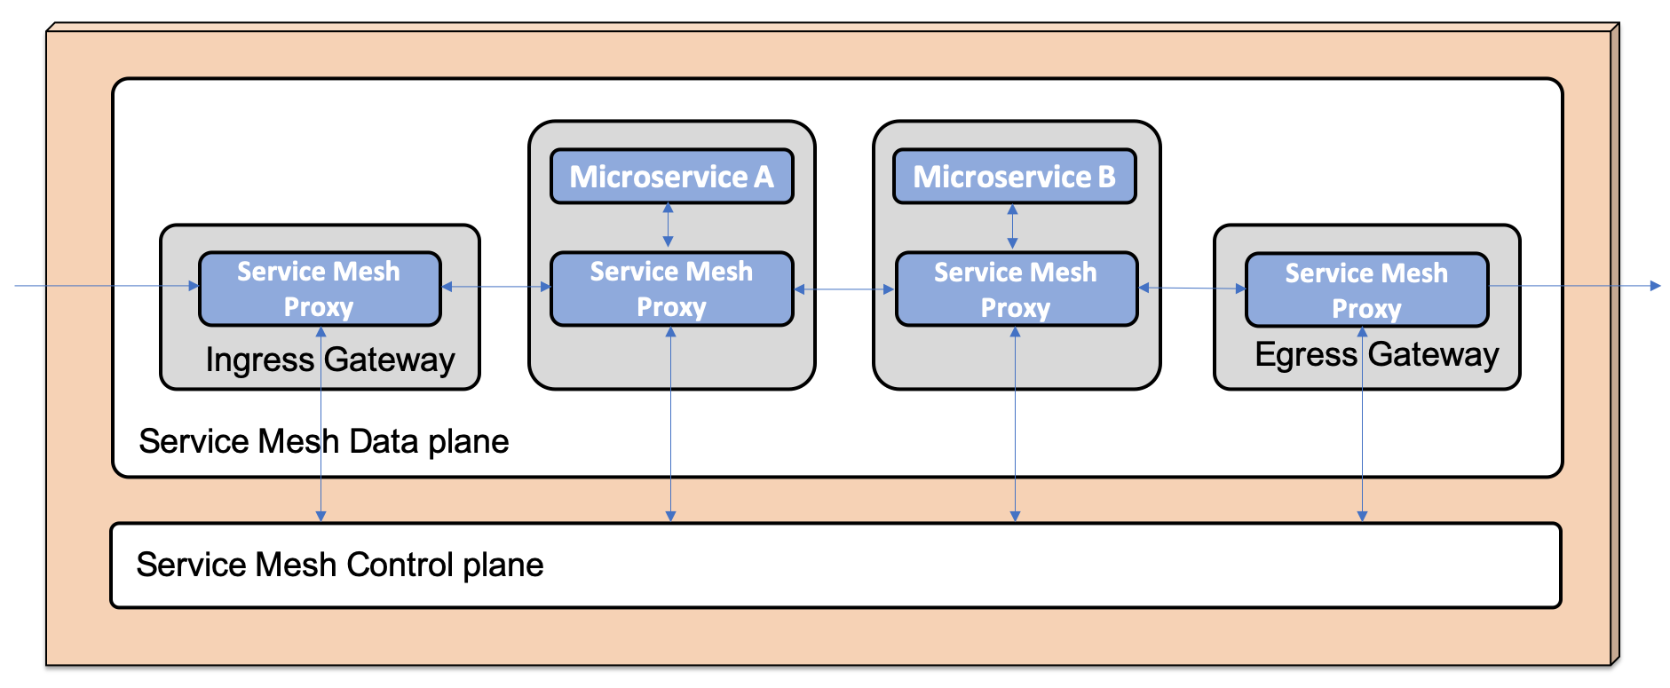
Kubernetes
01
Service Mesh Proxy
A service mesh is an infrastructure layer that controls and observes communication between services, such as micro-services
Service mesh controls and monitors the entire internal communication between micro-services to implement functions such as observability, security, policy enforcement, resiliency, and traffic management
The core component of the service mesh is the lightweight proxy, and all micro-service traffic is configured to pass through the proxy component
The service mesh control plane uses the proxy's public API to configure proxy components at runtime, collect telemetry data, and visualize flows

Slide 26
Kubernetes
01
Service Mesh Proxy
The data plane consists of a proxy component of the entire microservice belonging to the service mesh, and a separate component that handles traffic coming in and out of the service mesh. Service mesh public implementation: Linkerd, istio
The core proxy component of this organization is Envoy Proxy-based
Deploying an STIO to Kubernetes deploys runtime components to a separate Kubernetes namespace, istio-system
Estio can expand Kubernetes API by adding new objects with its own Custom Resources Definition (CRD)
ISIOctl, the CLI tool for ISIO, inserts the ISIO proxy into the microservice participating in the service mesh.
Estio is divided into control plane and data plane
The operator creates an Estio object that declares routing rules, etc. and uses the Kubernetes API server for this purpose
The control plane checks this object and sends commands to the data plane proxy to perform the task
Proxy handles communication between micro-services and sends telemetry data to the control plane

Slide 27
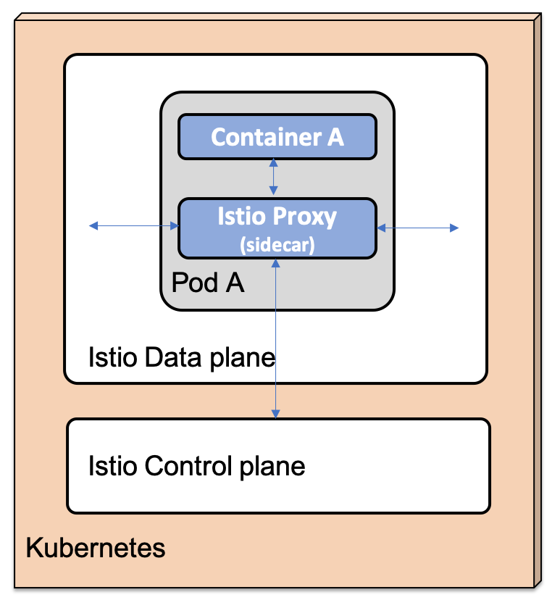
Kubernetes
01
Service Mesh Proxy
To join a microservice pod to an STIO-based service mesh, a container running the STIO proxy must be added to the pod to insert the STIO proxy
Containers added to pods for the purpose of supporting primary containers, such as the Estio proxy, are called sidecars

Slide 28
Kubernetes
01
Service Mesh Proxy
The primary container routes all traffic through the Estio proxy
The STIO proxy is inserted automatically when creating a deployment object. It can also be inserted manually through ISiotl
Use the following command to insert an Estio proxy into the pod of an existing deployment object
kubectl get deployment sample-deployment -o yaml | istioctl kube-inject -f - | kubectl apply -f -

Slide 29
Kubernetes
01
STIO API Object
Estio extends Kubernetes API with multiple objects added by CRD
Gateway: Configures how traffic enters and exits the service mesh is handled
The gateway relies on virtual services to route traffic entering the Kubernetes service
Virtual Service: Defining Routing Rules for Service Mesh
DestinationRule: Define policies, rules for traffic routed to a particular service by a virtual service; configure internal HTTP traffic encryption policy; define service subsets by service version
Policy: Define the request authentication method; use Policy to authenticate requests entering the service mesh using the JWT-based OAuth2.0/OIDC access token.

Slide 30
Kubernetes
01
Estio Runtime Components
Pilot: Forward updated service mesh configuration to full sidecar
Mixer: consists of two runtime components
Policy: Implementing network policies such as authentication, authorization, speed limits, quotas, etc
Telemetry: Collects telemetry information and sends it to Prometheus, etc
Galley: Collects, validates, and distributes configuration information to other STO components on the control plane
Citadel: Issuing and replacing certificates used internally
Kiali: Provides observability to the service mesh and visualizes ongoing work in the service mesh
Prometheus: Collects and stores time-series-based data of performance metrics
Grafana: Visualize performance metrics and time series data collected by Prometheus
Tracing: Processing and visualizing distributed tracking information. Based on open-source Jaeger for distributed tracking

Slide 31
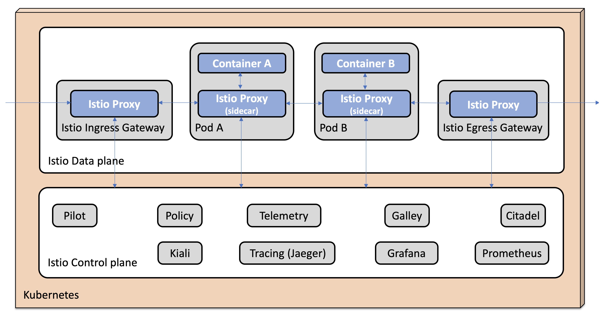
Kubernetes
01
Estio Data Plane
Ingress G/W: Handling traffic entering the service mesh
Egress G/W: Processing traffic out of the service mesh

Slide 32
Kubernetes
01
Changing the Microservice Environment
COOVENETIS' INGREES RESOURCE ALTERNATIVE BY USING STIO INGREES GATEWAY AS EDGE SERVER
Distributed tracking is possible by replacing Zipkin with Estio Jaeger components
Ingress fails to handle granular routing rules provided by Estio
Using Jaeger instead of Zipkin makes the environment much simpler
Remove zipkin dependencies from all microservice build files

Slide 33
Kubernetes
01
Deploying an Estio to a Kubernetes Cluster
curl -L https://git.io/getLatestIstio | ISTIO_VERSION=1.2.4 sh -

Slide 34
Kubernetes
01
Practice 1: Docker branch, spring-cloud-comm-master
discovery service
targetPort: 28096
nodePort: 30006
G/W
targetPort: 28095
nodePort: 30005
product service
order service
targetPort: 28090
nodePort: 30000
targetPort: 28093
nodePort: 30003
accout service
customer service
zipkin service
targetPort: 28091
nodePort: 30001
targetPort: 28092
nodePort: 30002
targetPort: 28094
nodePort: 30004

Slide 35
Kubernetes
01
Practice 1: Docker branch, spring-cloud-comm-master, docker build
docker build -t yklee2002/account-service .
docker push yklee2002/account-service
docker build -t yklee2002/order-service .
docker push yklee2002/order-service
docker build -t yklee2002/product-service .
docker push yklee2002/product-service
docker build -t yklee2002/customer-service .
docker push yklee2002/customer-service
docker build -t yklee2002/discovery-service .
docker push yklee2002/discovery-service

Slide 36
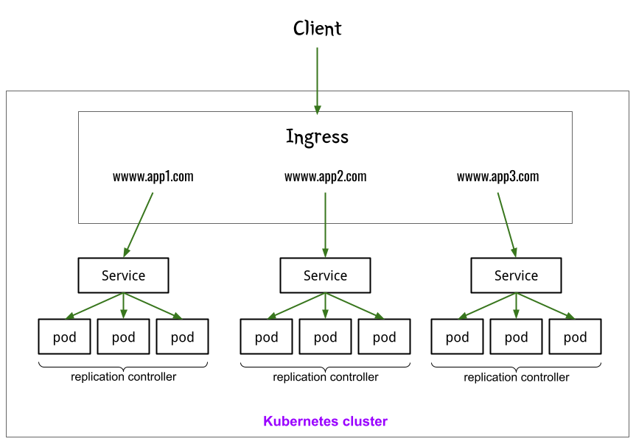
Kubernetes
01
Ingress 구성

Slide 37
Kubernetes
01
Ingress role
Kubernetes Ingress does what L7 load balancers do because it provides an interface to load open or commercial load balancers
It receives requests from clients and routes them to other services based on URLs, HOST names, or other metadata.
For example, a URL that starts with /music can be routed to a music service and to a URL photo service that starts with /photo.
In the case of the HOST name, if the value of the HOST field in the HTTP header is HOST: user.example.com , it can be routed to the payment service if it is HOST: payment.example.com .
Process SSL certificates for traffic.
Provides load distribution for incoming traffic.
It provides various functions such as rate limiting and user authentication.

Slide 38
Kubernetes
01
Ingress Controller
Kubernetes Ingress does what L7 load balancers do because it provides an interface to load open or commercial load balancers
It receives requests from clients and routes them to other services based on URLs, HOST names, or other metadata.
For example, a URL that starts with /music can be routed to a music service and to a URL photo service that starts with /photo.
In the case of the HOST name, if the value of the HOST field in the HTTP header is HOST: user.example.com , it can be routed to the payment service if it is HOST: payment.example.com .
Process SSL certificates for traffic.
Provides load distribution for incoming traffic.
It provides various functions such as rate limiting and user authentication.

Slide 39
Kubernetes
01
Creating an Ingress Example
sample-spring-cloud-comm-master progress
Delete the part that corresponds to the discovery service and gateway-service
Delete part of eureka dependency
Then create a docker image and upload it to docker hub
Deploy pod and nodeport services to Kubernetes
Create Ingress
minikube addons enable ingress
Verifying Ingress Generation
kubectl get pods -n ingress-nginx
ubuntu@ubuntu:~/kubetest$ kubectl get pods -n ingress-nginx
NAME READY STATUS RESTARTS AGE
ingress-nginx-admission-create-b5zpx 0/1 Completed 0 54m
ingress-nginx-admission-patch-stqsn 0/1 Completed 0 54m
ingress-nginx-controller-7c6974c4d8-dpmhf 1/1 Running 0 54m

Slide 40
Kubernetes
01
Example of Ingress: Path-Based Routing=> Path-ingress.yaml Creation
apiVersion: networking.k8s.io/v1
kind: Ingress
metadata:
name: path-ingress
spec:
rules:
- http:
paths:
- path: /account
pathType: Prefix
backend:
service:
name: account-service
port:
number: 30001
- path: /order
pathType: Prefix
backend:
service:
name: order-service
port:
number: 30000
- path: /customer
pathType: Prefix
backend:
service:
name: customer-service
port:
number: 30002
- path: /product
pathType: Prefix
backend:
service:
name: product-service
port:
number: 30003

Slide 41
Kubernetes
01
Example of Ingress: Path-Based Routing=> Path-ingress.yaml Creation
path-ingress.yaml apply
Confirm path-ingress creation with kubectl get ingress
ubuntu@ubuntu:~/kubetest$ kubectl get ingress
NAME CLASS HOSTS ADDRESS PORTS AGE
example-ingress nginx hello-world.info 192.168.59.100 80 55m
path-ingress nginx * 192.168.59.100 80 114s
kubectl describe ingress path-ingress content confirmation
Host Path Backends
---- ---- --------
/account account-service:30001 (10.244.0.74:28091)
/order order-service:30000 (10.244.0.75:28090)
/customer customer-service:30002 (10.244.0.77:28092)
/product product-service:30003 (10.244.0.76:28093)

